Slide 1

Recipe Site Traffic
Damodhar Jangam
Datacamp
December 2023Knowing whether it's measured by recipe views or user interactions can help define better business metrics.

Slide 2
Table of Contents
1
2
3
4
Introduction
Methodology
Introducing the project and its business goals
Outline the methodology used and describing the dataset
Key Findings
Recommendations
Key metrics and current estimation
Specific recommendations to improve Tasty Bytes traffic

Slide 3

Introduction
Tasty Bytes, is a meal plan subscription service that provides healthy and balanced recipes to customers, along with ingredient, delivery through online.
Currently, the team selects their preferred recipe from a pool and showcases it on the homepage.
They have observed that displaying a popular recipe can increase the website traffic by up to 40%, but they do not have a method to determine the recipe's popularity in advance.
More traffic means more subscriptions, so this is really important to the company.

Slide 4
Business Goals
1
2
Identify the popular recipes
Correctly predict high traffic recipes 80% of the time
Predict which recipes will result in high traffic by identifying the key features.
Develop Machine Learning methods to predict recipe popularity.

Slide 5






The dataset - 947 recipes
Calories
Protein
Sugar
Number of calories
Amount of protein in grams
Amount of sugar in grams
Carbohydrate
Servings
Category
Amount of carbohydrates in grams
Number of servings for the recipe
We have 10 recipe categories

Slide 6
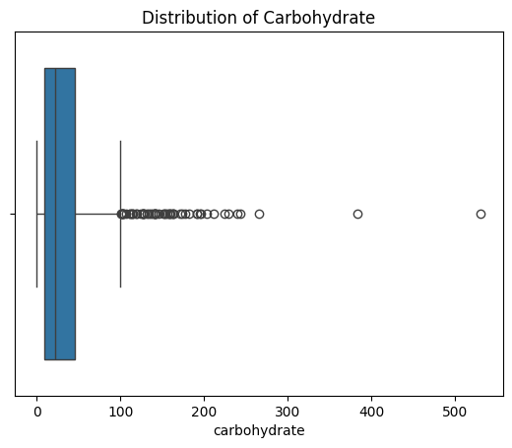
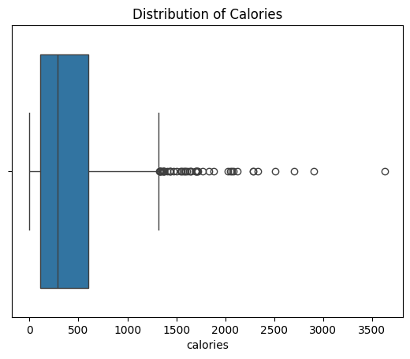
Plots

Slide 7
Methodology: How we approached the problem
Clean the data
Validate the data
Exploratory Data Analysis
ML techniques
Results
Remove errors and inconsistencies
Ensure the data type are correct
Analyse and visualize data
Train and evaluate models
Summarize and interpret findings
1
2
3
4
5

Slide 8
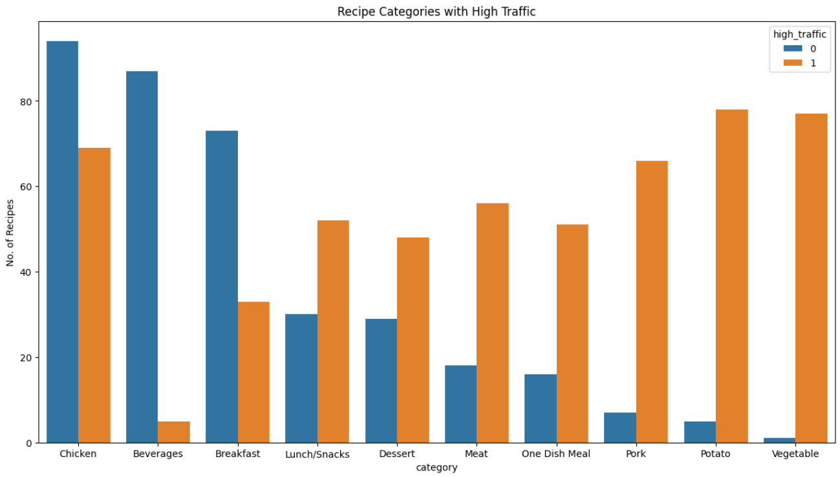
Exploratory Data Analysis

Slide 9

Feature selection
 | Feature | Feature | Feature
Strong positive association | Vegetable | Potato | Pork
Strong negative association | Beverages | Breakfast | Chicken
Weak association | Servings | Protein | Calories

Slide 10
Machine Learning techniques
97.37%
96.61%
Logistic Regression
Random Forest
We measured how well the models were able to predict which recipe will be popular using a measure called accuracy. It compares the predictions to the actual outcomes with prediction probability 80%

Slide 11

Business metrics
Given the goal to increase website traffic and the data available, a potential business metric could be the percentage of high-traffic recipes.
In our dataset, 60% of the recipes are considered high-traffic.
In the future, if this percentage increases, it indicates a successful increase in website traffic.
Obs! The available data is insufficient to develop a relevant business metric.

Slide 12

Recommendations
Increase and reduce the number of recipes from some categories
We recommend that Tasty Bytes display more recipes from categories such as Vegetable, Potato, and Pork while reducing the number of Beverages and Breakfast recipes.
Including other important factors
We suggest including other important factors such as recipe ingredients, preparation time, instructions, and overall appeal of the recipe on the site.

Slide 13
How is the traffic measured?
1
2
Although it was noted that displaying popular recipes increases website traffic by up to 40%, it's unclear how the traffic it's measured. Knowing whether it's measured by recipe views or user interactions can help us define better business metrics like CTR or CR.
Click-through rate
Conversion rate
Measures the percentage of users who view a recipe and click on it.
Measures the percentage of users who view high-traffic recipes and then interact with them.

Slide 14
Thank you!

